Slide 1
Software Requirements Specification for Online Course Enrollment System
Nkosinomusa Gwalla
CST499: Capstone for Computer Software Technology
Professor Joseph Rangitsch
April 7, 2025

Slide 2
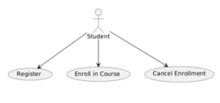
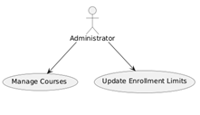

Introduction
This section documents software specifications for The Online Course Enrollment System.
Key features include
secure account management
authentication and enrollment
capacity limits and waitlist management
notification systems for enrollment cancellation requests.
It follows IEEE guidelines for software requirements documentation
Beneficiaries include developers, project managers and testers , and stakeholders (course administrators and IT staff)
The key users of the system are:
Students - access to course details and enrollment options.
Administrators - manage courses, update enrollments, and maintain integrity
Support Staff - resolving technical issues and guiding system usage.
Notes:
Key functionalities include:
User Registration: Unique user ID creation, password setup, and profile details input (name, phone, email, etc.).
Authentication: Secure login process for registered users.
Course Enrollment: Display of course offerings by semester, enforcement of enrollment limits, and waitlist capabilities.
Cancellation and Notification: Ability to cancel enrollment with automatic notification sent to the first waitlisted student. This system is envisioned as a key component of the institution’s broader digital transformation in course management.
Main Users:
Students:
Primary users who enroll in courses.
Require straightforward access to course details and enrollment options.
Administrators:
Manage course offerings, update enrollment limits, and maintain overall system integrity.
Typically have advanced technical expertise and higher security privileges.
Support Staff:
Resolving technical issues and guiding system usage.
Focuses on user support rather than direct system management.

Slide 3
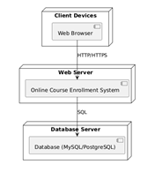
Requirements of the System
The system is designed to operate in a modern, web-based environment.
Key characteristics include:
Platform: Accessible via standard web browsers (Chrome, Firefox, Edge) on desktop and mobile devices.
Server Environment: Hosted on web servers with a backend relational database (e.g., MySQL or PostgreSQL) to store user and course data.
Integration: Capable of interfacing with external systems, such as the Student Information System for data synchronization and an Email Notification Service for communication.
Notes:
The development of the system is subject to several constraints, including:
Compliance: Must adhere to institutional IT policies and applicable data privacy regulations.
Integration: Requires seamless integration with the existing Student Information System and third-party email services.
Technology: Utilizes Git for version control and hosts the repository on GitHub.
Performance: Designed to handle concurrent user sessions with a fast response time under load.

Slide 4
Features of the System
Feature | Description/Priority | Functional Requirements
User Registration and Profile Creation | High-priority capability enables fresh users to establish their account | Enforce uniqueness of the user ID during registration Capture and securely store user profile details Display a confirmation message and send an email notification upon successful registration
Login and Authentication | high-priority feature allows registered users to access the system securely A user enters their user ID and password on the login page | The system shall validate user credentials against stored records. The system shall implement password encryption and automatically lock out accounts after a specified number of failed login attempts.
Course Enrollment and Waitlist Management | Process management for course enrollment stands among top features. A student selects a course for enrollment. The system checks the enrollment count. | The system shall display each course's maximum capacity and current enrollment count. The system shall allow a student to join the waitlist if a course has reached its maximum enrollment. The system shall automatically notify the first student on the waitlist when a spot becomes available due to an enrollment cancellation.
Course Catalog Management | This medium-priority feature provides a comprehensive view of the course offerings by semester. A user accesses the course catalog page. The system retrieves and displays a list of courses filtered by semester | The system shall allow filtering of courses by semester (e.g., spring, summer, fall). The system shall display detailed course information, including course title, instructor, schedule, and maximum enrollment capacity.
Enrollment Cancellation Process | This high-priority feature allows students to cancel their course enrollments. A student initiates a course enrollment cancellation from their account. The system processes the cancellation, updates the course's enrollment count | The system shall allow students to cancel their course enrollments through their account interface. The system shall update the course's enrollment count immediately after a cancellation is processed. The system shall notify the first student on the waitlist when a cancellation creates an available slot.
Notes:
User Registration and Profile Creation - enables fresh users to establish their account through the provision of a distinctive user ID along with necessary personal information that includes name and phone number and email. The registration step serves as a necessary beginning that lets users access every system capability.
Login and Authentication - allows registered users to access the system securely through login with their credentials. This feature utilizes two essential security functions which consist of password encryption processes and account locking during consecutive failed access attempts.
Course Enrollment and Waitlist Management - Students can select available courses through the enrollment system before the course fills up and they can enter a waiting position for full seats.
Course Catalog Management - It helps both students and administrators by displaying course details such as descriptions, schedules, and enrollment limits.
Enrollment Cancellation Process - Once a cancellation occurs, the system updates the enrollment count and notifies the next student on the waitlist, ensuring that open slots are promptly filled.

Slide 5
External Interface Requirements
Requirement | Expected Characteristics
User Interfaces | Consistent Layout, Accessibility, Standard Elements, Visual Design, Help and Tutorials
Hardware Interfaces | Supported Devices, Supported Devices, Communication Protocols
Software Interfaces | Database Management, Student Information System (SIS), Email Notification Service, Authentication Libraries
Communications Interfaces | Web Communication, Email Communication, Data Synchronization, Network Protocols
Performance Requirements | Response Time, Concurrent Users, Scalability, Load Balancing
Safety Requirements | Data Backup, Failover Mechanisms, Error Handling
Security Requirements | Data Encryption, Authentication, Access Control, Vulnerability Management, data protection regulations
Software Quality Attributes | Usability, Reliability, Maintainability, Portability, Interoperability, Testability
Notes:
The Online Course Enrollment System is designed with a responsive, web-based user interface that adapts seamlessly across desktops, tablets, and smartphones.
The system operates primarily as a web-based application and does not require specialized hardware.
The system integrates with several external software components to support its core functionalities.
The system’s communication requirements focus on secure, reliable data exchange.
The system is designed to provide a responsive and scalable user experience.
It incorporates safety measures to prevent data loss and ensure business continuity

Slide 6
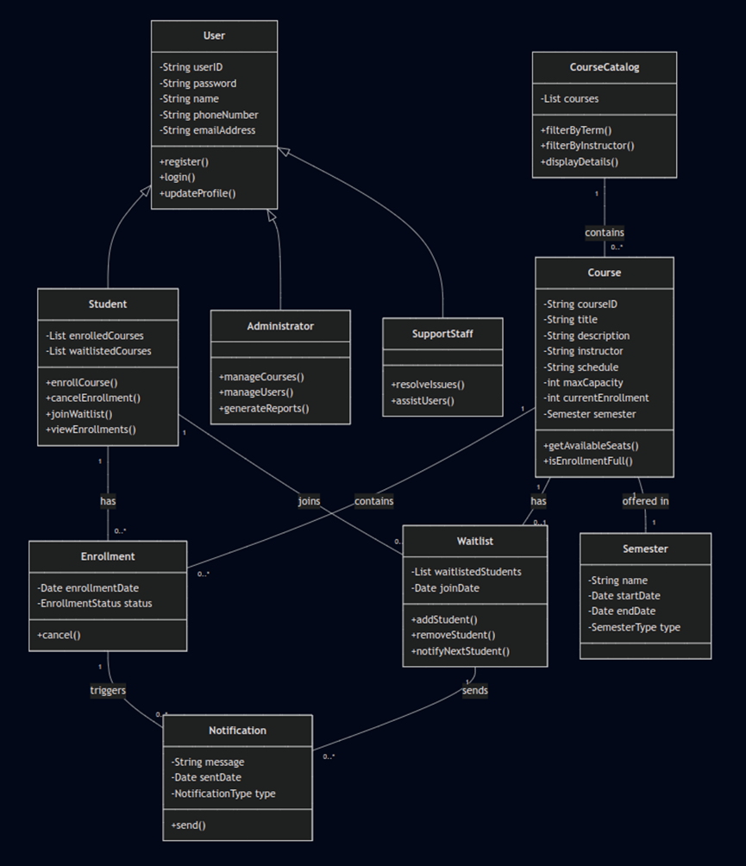
UML Design Modeling for Online Course Enrollment System
The system is designed using four models:
Class diagram
Activity diagram
Sequence diagram
Static diagram
Class Diagram (Figure 1)
Shows a static structure of the system
Main classes include:
User class
Enrolment class
Notification class
Waitlist class
Figure 1. Class Diagram
Notes:
The User class is the main parent entity within the system with sub-classes: Student, Administrator, and SupportStaff
Polymorphic inheritance structure enables different user types to access the system
Many-to-many relationships allow a single Student object to connect to various Enrollment classes and Waitlist classes
Many-to-one relationships exists for a course in the Course class to link Enrollment and Waitlist.
The Notification class serves as a bridge between both Enrollment and Waitlist classes

Slide 7
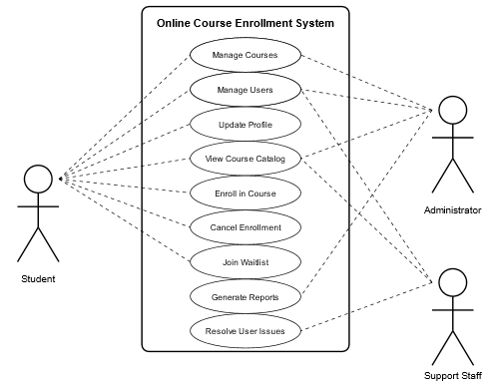
Use case diagram (user interactions)
Captures the interactions between the system and its external actors.
The actors are Students, Administrators, and Support Staff
This diagram communicates the system's boundary and the various ways users interact with it.
It provides a high-level view of system functionality
Figure 2. Use Case Diagram
Notes:
Roles include:
Students - registering accounts, logging in, updating profiles, viewing course catalogs, enrolling in courses, canceling enrollments, and joining waitlists.
Administrators manage courses, users, and generate reports.
Administrators can also view the course catalog and log in.
Support staff – perform troubleshooting tasks (resolving user issues)
Support Staff can also access the system through login and view course information.

Slide 8
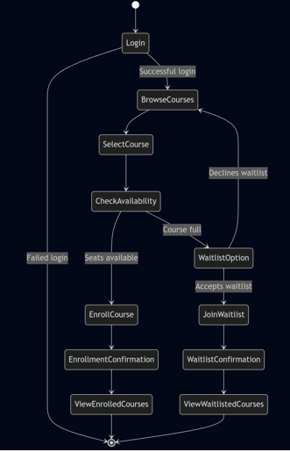
Activity diagram
Shows the course enrollment workflow
It involves the order of student enrollment actions
These are decision making points before course selection.
Courses are displayed following authentication of login credentials
Figure 3. Activity Diagram
Notes:
The student determines the next course action by checking seat availability which leads them to enrollment process when spots exist or waitlisting when courses reach full capacity.
The diagram presents both main and alternative stages along with their triggered conditions which results in an extensive display of enrollment process pathways.
The visual layout shows developers which sequence of operations must be implemented to create the core functionality.

Slide 9
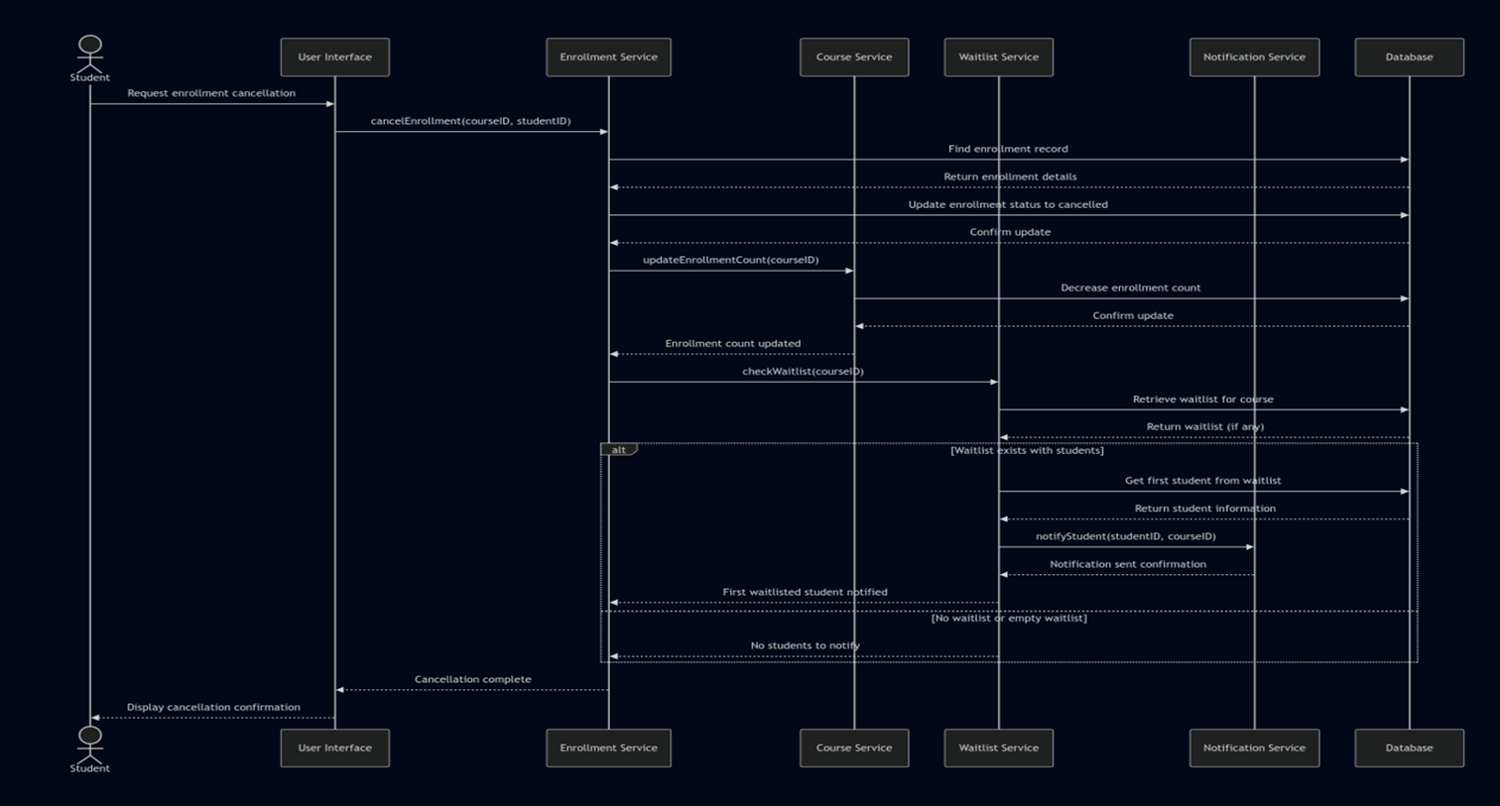
Sequence diagram (dynamic behavior)
It shows chronological process of cancellation enrollment
Students initiate cancellations.
It is transmitted via the User Interface to Enrollment Service.
The action then updates database enrollment records.
Figure 4. Sequence Diagram
Notes:
Figure 4 displays actions of updating enrollment counts by the Course Service.
It also shows actions from the Waitlist Service which identifies and informs the subsequent waitlisted student about available positions.
Thirdly, it displays the series of distributed messages sent between program elements.
This enables developers can track the timing behavior alongside dependency relationships across this essential workflow and follow every necessary step.

Slide 10
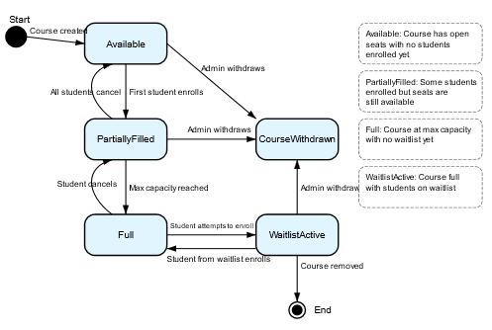
Static Diagram
Figure 5 displays the lifecycle of the course.
This lifecycle has the following status/modes:
"Available“ – no student enrolled yet
"PartiallyFilled“ – some enrolment available
"Full" status - maximum enrollment
"WaitlistActive" - the course is full
Figure 5. Static Diagram
Notes:
The diagram also shows how a course can transition back to previous states when students cancel enrollments or how it can move to a "CourseWithdrawn" state by administrative action.
Each transition is labeled with the event that triggers it, providing clear documentation of the conditions under which a course's state changes.
This model is particularly valuable for implementing the course management aspects of the system.

Slide 11
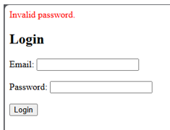
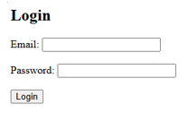
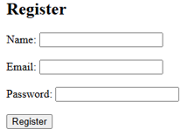
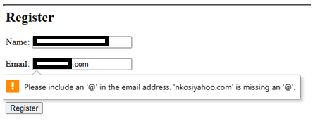
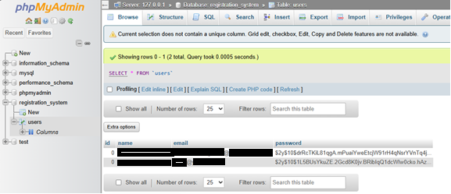
Landing, Login, and Enrollment Pages Development
Procedure
New users fill out a form that validates username and password input.
Upon validation and unique username, the password is hashed and saved to the `users` table.
A Bootstrap-styled form collects username and password input
PHP checks for empty fields and ensures password is at least six characters
The password is hashed with `password_hash()` before insertion
A prepared INSERT query saves the user to the `users` table.
This process ensures a secure and user-friendly registration experience
Notes:
The development phase successfully delivered a functional PHP web application with user login and registration capabilities.
The pages interact with a MySQL database using prepared statements and a custom database class.
Passwords are securely stored, and input validation ensures reliable user interaction.
These foundational features are critical for expanding the application in future weeks. Screenshots and structured code demonstrate the use of modern security practices and responsive design principles.
Users input their credentials. If verified using PHP’s `password_verify()` function against hashed values in the database, a session is started and they are redirected.
The `users` table was created to store user credentials
The table stores hashed passwords using `password_hash()` and ensures that usernames are unique.
A PHP class was created to manage MySQLi database connections. This class centralizes the connection logic, improves code reusability, and supports prepared statements

Slide 12
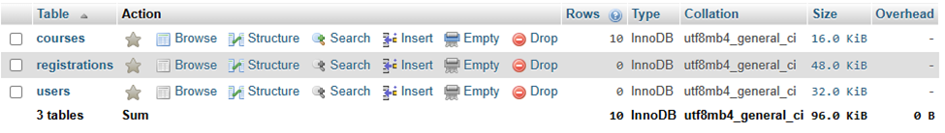
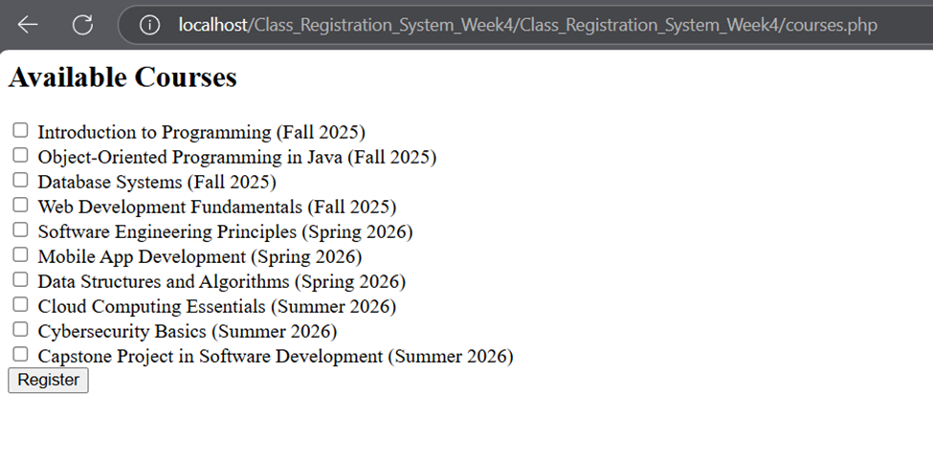
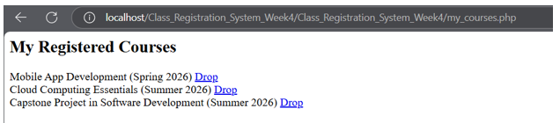
Class Registration System Implementation and Database Design
MySQL Database Design and Implementation
The database schema includes three primary tables: users, courses, and registrations.
The users table stores login credentials, the courses table holds class information, and the registrations table maps users to the courses they are enrolled in.
The design enforces referential integrity and supports dynamic course management.
Notes:
This is a working system that supports course registration, listing, and management. The database was successfully connected to dynamic PHP pages, allowing users to register, add, and delete courses from their schedule. The implementation is functional, scalable, and adheres to best practices in both backend and frontend development

Slide 13
Testing Levels for the Online Course Enrollment System
Component Testing - examines solitary software components for proper functionality (unit testing approach) (Sommerville, 2016)
Integration Testing - interactions between integrated components or subsystems to detect interface defects (Myers et al., 2021).
Bottom-up testing: lower-level components (Database access layer)
Top-down testing: User Interfaces first
System Testing - complete integrated system fulfills its specified requirements (Sommerville, 2016)
Acceptance Testing –prescribed acceptance standards and delivery readiness to end users (Myers et al., 2021).
Alpha testing - selected users performing specific tasks while developers observe and note issues
Beta testing: A broader group uses the system in their own environments and report issues
Notes:
Component Testing - will primarily use white-box testing techniques, where testers have knowledge of the internal structure of the code.
Automated testing frameworks appropriate to the implementation language will be employed to create and run test cases.
This level of testing serves as the foundation for ensuring individual building blocks of the system work correctly before they are integrated.
Integration Testing - will verify that components work together as expected when combined.
Enrollment process chain: Testing the interaction between the User Interface, Enrollment Service, Course Service, and Database components
Waitlist-to-enrollment workflow: Testing the sequence of actions that occur when a spot becomes available and a waitlisted student is notified and subsequently enrolled.
User authentication and authorization flow: Testing how the authentication mechanism integrates with the authorization
System Testing
This is focus on functionality and execution performance alongside security measures and user experience of the system.
It assesses the functionality of the system through black-box analysis without examining its code base.
Key aspects include:
Functional testing: Verifying all use cases work correctly from end to end.
Performance testing: handle the specified load of 500 concurrent users during peak enrollment
Security testing: the system protects sensitive student information,
Usability testing: user interface for ease of use and accessibility
Database testing: data integrity, transaction handling, and proper storage and retrieval of information.
Acceptance Testing
This is the final validation before system deployment.
It focuses on Functional completeness, performance requirements, usability requirements, and security requirements.

Slide 14
References
Bourque, P., Dupuis, R., Abran, A., Moore, J. W., & Tripp, L. (2002). The guide to the software engineering body of knowledge. IEEE Software, 1(6), 35–44.
Elmasri, R., & Navathe, S. B. (2017). Fundamentals of database systems (7th ed.). Pearson.
HTTPLocalhost Info. (2024). Introduction to XAMPP. http://httplocalhost.info/xampp
IEEE Computer Society. (1998). IEEE recommended practice for software requirements specifications (IEEE Std 830-1998). IEEE. https://standards.ieee.org/standard/830-1998.html
Myers, G. J., Sandler, C., & Badgett, T. (2021). *The art of software testing* (3rd ed.). John Wiley & Sons.
PHP Documentation. (2023). password_hash - PHP manual. https://www.php.net/manual/en/function.password-hash.php
Schach, S. R. (2011). Essentials of software engineering (3rd ed.). McGraw-Hill Education.
Sommerville, I., Fowler, M., Beck, K., Brant, J., Opdyke, W., & Roberts, D. (2019). Software engineering (10th ed.). Pearson.
Tutorial Republic. (n.d.). PHP MySQL login system tutorial. https://www.tutorialrepublic.com/php-tutorial/php-mysql-login-system.php
Wiegers, K. E., & Beatty, J. (2013). Software requirements (3rd ed.). Microsoft Press. https://www.microsoftpressstore.com/store/software-requirements-9780735679665

